Slide 1








The 4th Mission – The need for a global plot based biomass reference
Dmitry Schepaschenko
J. Chave, S. Davies, R. Dubayah, T. LeToan, S. Lewis,
O. Phillips, S. Quegan, S. Saatchi, K. Scipal
31/10/2016

Slide 2


3 Spaceborne Missions to measure forest structure
Question:
Are we able to make best use of these missions?
Will our users trust our products?
BIOMASS
These missions will deliver measurements of
forest height
forest biomass
biomass change
Notes:
Measuring forest structural parameters is high on the scientific and political agenda.
Global measurements of biomass and forest height and how they change with time is urgently needed not only in the context of climate change but also to understand how this important ecosystem functions.
ESA and NASA reacted to this need by selecting and implementing dedicated satellite missions.

Slide 3
The remote sensing challenge
Algorithm development: To derive AGB we need algorithms that are trained/calibrated with reference data of known quality.
Product Validation: Assessing uncertainty in the data products requires validation with reference data of known quality.
Notes:
RS measures structural features not AGB. See examples of the past (extremely successful AGB products from Saatchi or Baccini, all based on ground plot data)
To make optimum use of this satellite missions we need ground observations for algorithm training and product validation.

Slide 4
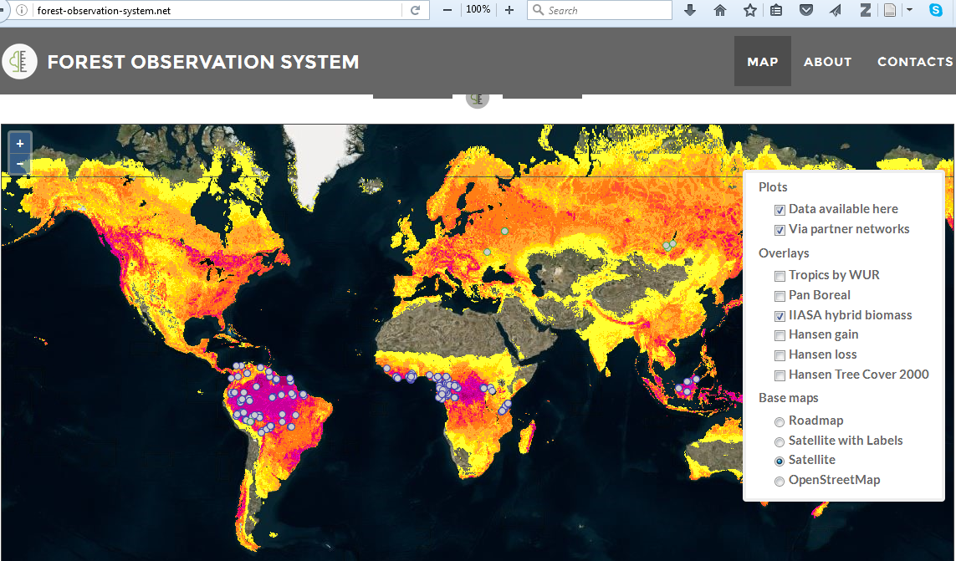
FOS: Forest-Observation-System.net
Notes:
An attempt to access this existing data is FOS

Slide 5
The Background of FOS
Forest-Observation-System.net (FOS) is a “Cyberinfastructure” to collect and disseminate ground data.
FOS is tailored to the needs of the EO community. FOS shall not compete against existing initiatives such as ForestPlots, CTFS-ForestGeo, etc.
The Guiding Principles of FOS
FOS aims at building an interface between well established, existing networks and the EO community.
FOS has an inclusive approach: FOS data should not be Mission or Network specific
FOS focus is on high quality datasets that are fit for the EO purpose (e.g. geocoded data, plots with a history, etc) based on traceable and documented requirements.
FOS data is available free & open in a unified format.
FOS collects, but does not distribute tree level data. FOS only distributes aggregated data (following a standardized and transparent process to go from tree to plot level)

Slide 6
FOS schedule
Phase 1 (2016) – Demonstration
Set up the infrastructure & webportal
Establish a collaboration with RAINFOR, AfriTron and CTFS-ForestGEO
Run the webportal in a Demo Mode including first data
Phase 2 (2017 - 2020) – Implementation
Open the webportal to the general public
Identify and establish collaboration opportunities with research teams and networks collecting high quality data
Identify gaps and encourage investment in field-based observations

Slide 7
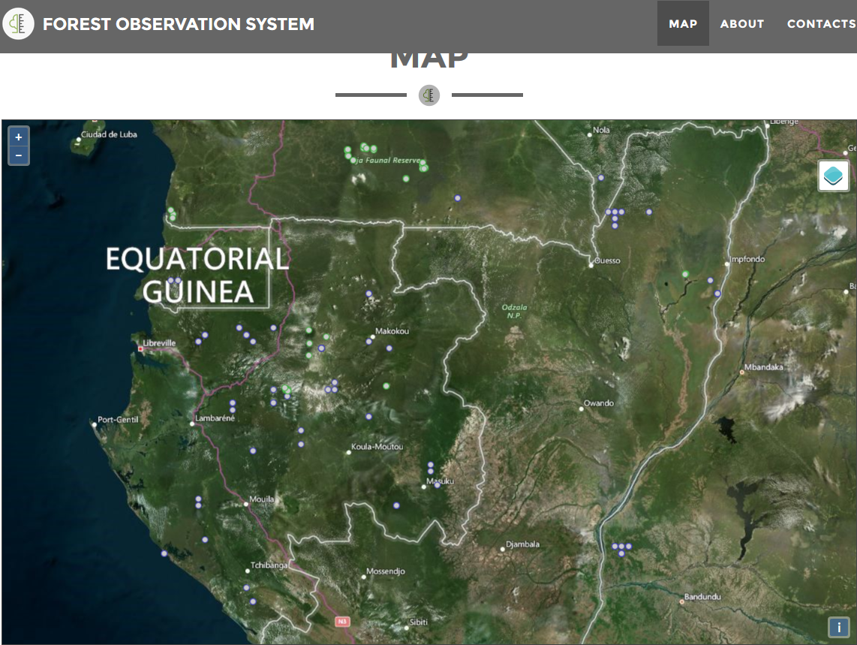
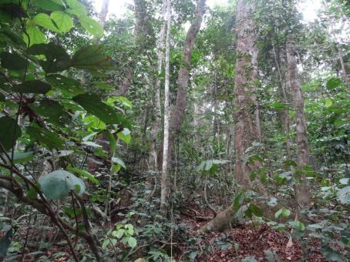
ArfiSAR ESA field complain 2016, Gabon
PlotCode: LNL-07 CountryName: Gabon Altitude: 306 m Slope: 7 deg PlotArea: 1.02 ha Network: FOS Link: http://forest-observation-system.net PI: Simon Lewis, Nicolas Labrière ForestStatus: Secondary forest, maturing (>50yr) YearEstablished: 2016 YearLastCensus: 2016 H Average: 19 m; H Max: 45.6 m AGB Local HD: 332.1 t/ha AGB Feldpausch: 343.2 t/ha AGB Chave: 331.6 t/ha
Taxonimic Identification 187 (65 %) - Aucoumea klaineana 78 (12 %) - Sacoglottis gabonensis 53 (7 %) - Lophira alata 22 (2 %) - Dialium lopense 25 (2 %) - Barteria fistulosa

Slide 8
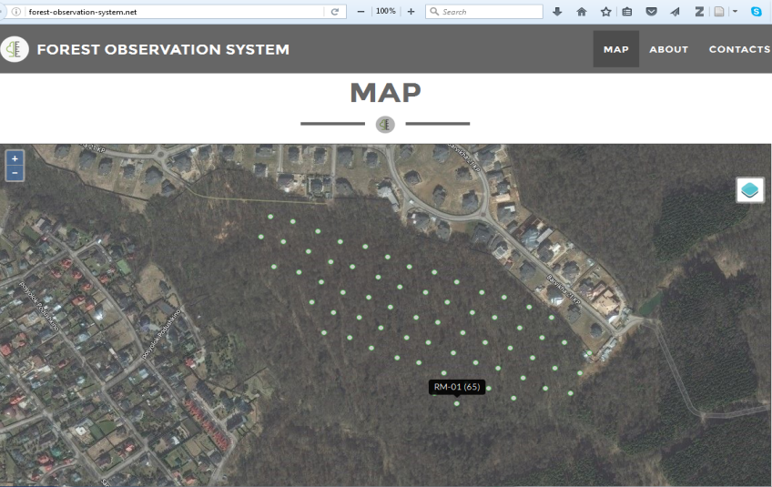

Protected area inventory near Moscow (17 ha divided by 0.25 ha sub-plots)
PlotCode: RM-01 (65) CountryName: Russia PlotArea: 0.25 ha Network: IIASA/MSFU Link: http://www.mgul.ac.ru/eng/ PI: P.V. Ontikov Year: 2014
H Average: 24.53 m H Max: 28.95 m AGB Local HD: 221.365 t/ha
Taxonomic Identification 216 (75 %) - Betula pendula 32 (20 %) - Quercus robur 8 (3 %) - Picea abies 16 (2 %) - Alnus incana 4 (0 %) - Populus tremula

Slide 9
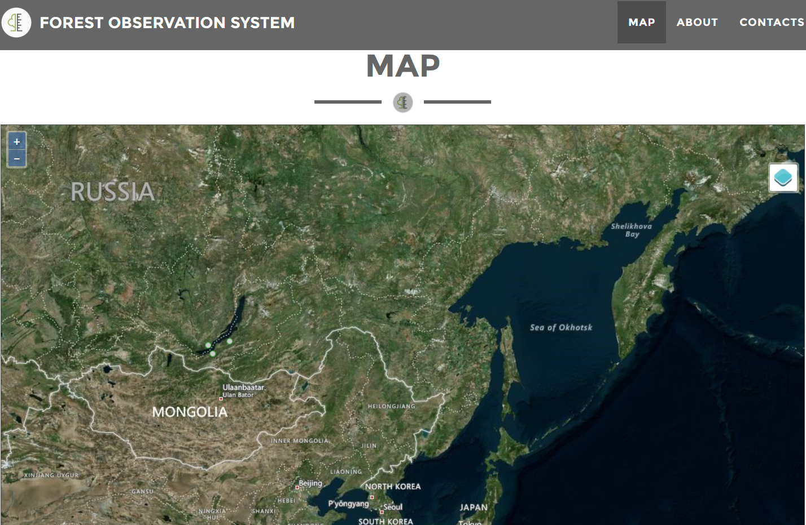

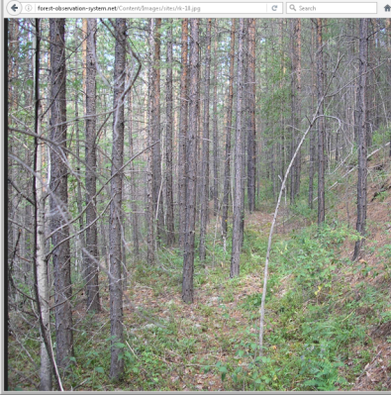
Post-fire forest dynamics and coarse woody debris decomposition investigation
PlotCode: RK-10 (1) CountryName: Russia PlotArea: 0.25 ha Network: IIASA/IF Link: http://forest.akadem.ru/PerSyst/ PI: V.V. Ivanov, E. F. Vedrova, L. V. Mukhortova Year: 2007 Image: RK 10
H Average: 10.3 m AGB Local HD: 73.93 t/ha Wood Density: 0.495 t/m³
Taxonomic Identification 2736 (96 %) - Pinus sylvestris 85 (2 %) - Pinus sibirica 86 (2 %) - Larix gmelinii

Slide 10
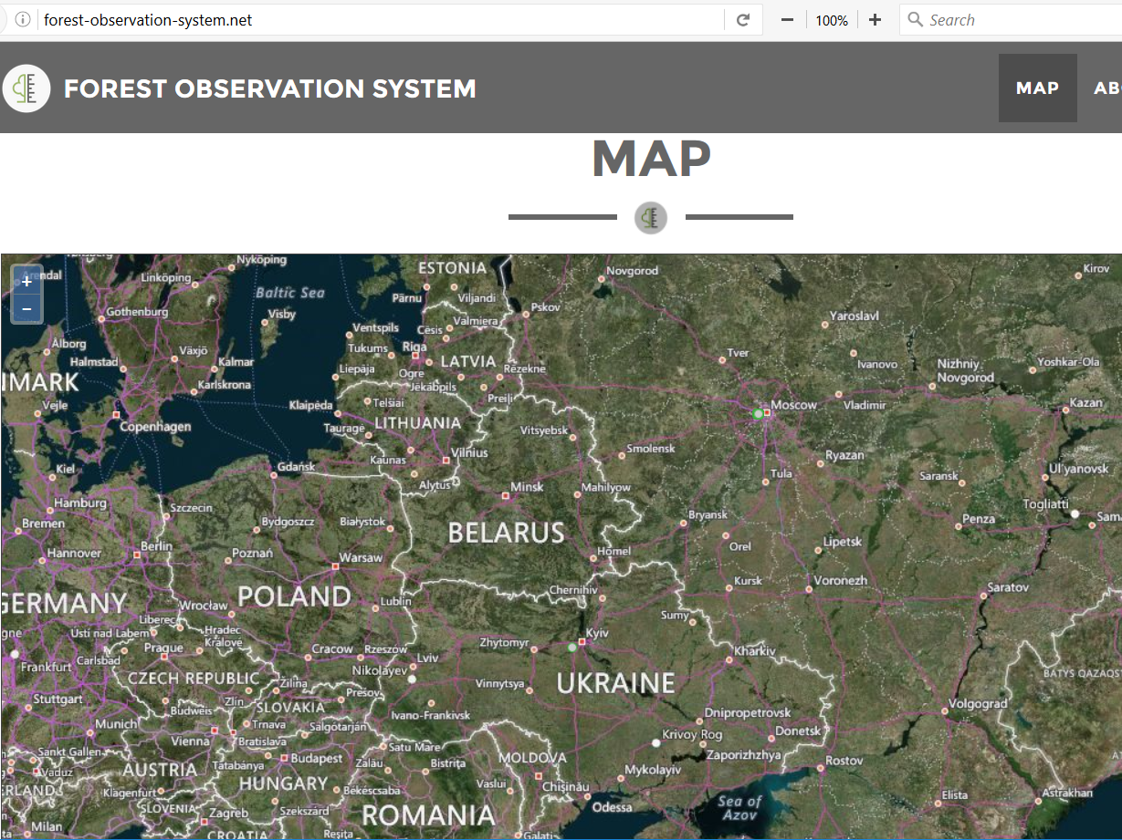

Long term (since 1956) study of forest stand dynamics by Kyiv, Ukraine
FOS is only the infrastructure we need to fill it with data
PlotCode: UK-53 (1) CountryName: Ukraine PlotArea: 1.2 ha Network: IIASA/NULESU Link: http://nubip.edu.ua/en/node/1665 PI: P.I. Lakyda, O. Morozyuk Year: 2015
H Average: 41 m H Max: 45 m AGB Local HD: 273 t/ha
Taxonomic Identification 0 (100 %) - Pinus sylvestris

Slide 11
Access to data when we need and where we need it is not guaranteed
We need matching data in time when the missions will fly.
We need data along local and global gradients.
We need accurate data (accurate tree dimensions, accurate species identification, accurate geolocation, if possible accompanied by lidar surveys).
TAKE HOME MESSAGE #1
The value of FOS for EO is in the quality of its data.
Data access in future cannot be taken for granted.
Notes:
So far we only work with historic data. The collection of this data has been funded by various sources but not by the EO community.
Data is available now, but access when we need them is not granted. Especially as we have specific needs (like geolocation)

Slide 12
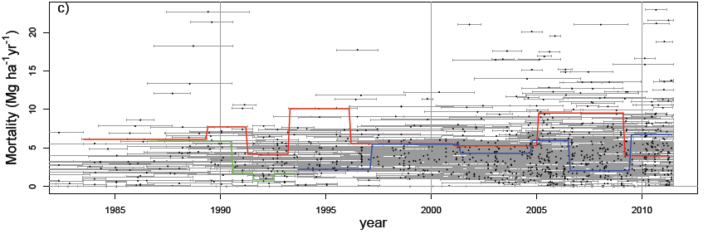
1. Synchronising measurements: Forest constantly change!
What makes it so difficult – 3 challenges
Amazon drought
Amazon drought
Pan-Amazon plot biomass dynamics, Brienen et al. 2015. Nature
Notes:
Plenty of data exists but we cannot use data that is 5 years old. Data has to be synchronized with the EO acquisitions
Brienen et al. is “Long-term decline of the Amazon carbon sink”, published in 2015

Slide 13
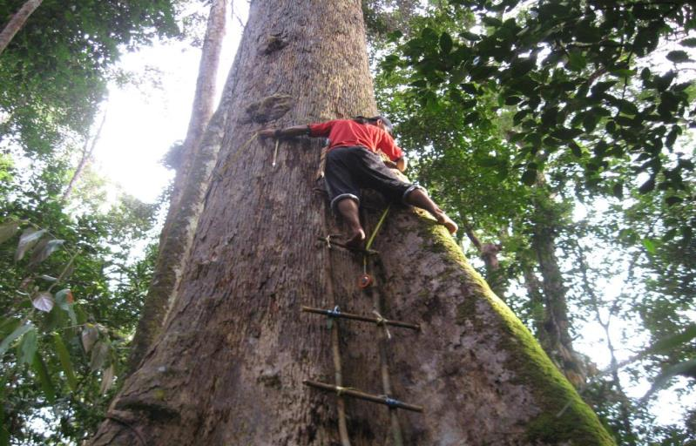
What makes it so difficult - 3 challenges
2. Collecting accurate data in a challenging environment
Notes:
It looks trivial but measuring trees is a surprisingly tricky business.
Big tropical trees have big buttresses, and we need to get above them to measure the trunk diameter. Only then can we work how much biomass is in the tree. So the ‘point’ of measurement really matters.
And this is only one challenge. Other challenges include working in hostile countries, wild animals, …

Slide 14
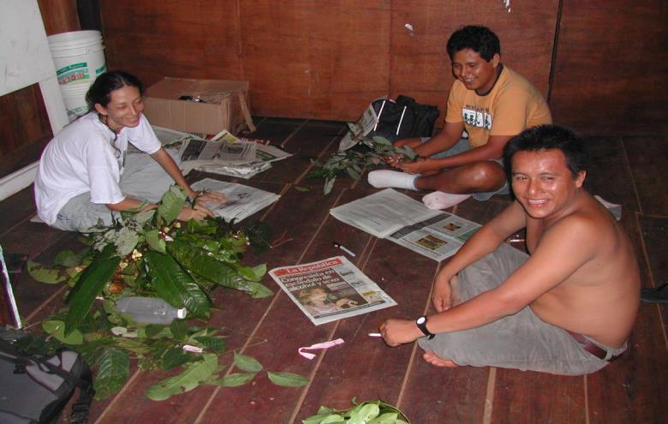
What makes it so difficult - 3 challenges
3. Accurate botanical identification requires skill and experience
TAKE HOME MESSAGE #2
Measuring AGB on the ground may look trivial but it is surprisingly tricky, tedious hard work and expensive.
It requires people with special skills, time and funding!

Slide 15
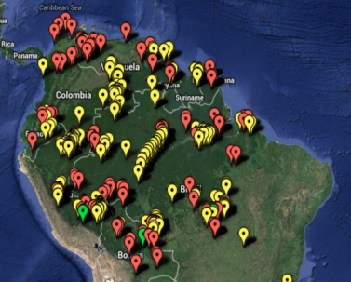
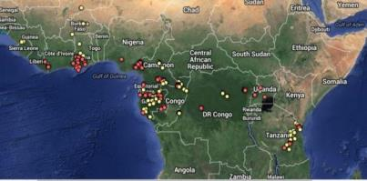
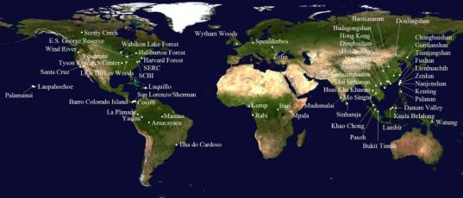
The good news: We don’t need to start from scratch
RAINFOR (Red Amazonica de Inventarios Forestales)
500 biomass & dynamics plots
AfriTRON (African Tropical Forest Observation Network)
> 250 biomass plots
CTFS-ForestGEO
61 large dynamic plots,
ca. 30 tropical
Notes:
We don’t need to start from scratch to populate FOS. But this is historic data which was collected under a huge effort.
We cannot take this data as granted and certainly we can not expect that this data is available once the missions will fly.

Slide 16




































These networks have a long history and experience building on a network of cooperating partners and mutual trust
RAINFOR Partners
Notes:
It is not only about money. A trained workforce is needed to collect all the data
This is to illustrate that even if we have global networks, these all rely on a well established co-operation. Typically this takes
time and trust.
The EO community has to respect these ties and networks and we should make use of them rather to invent something new.

Slide 17
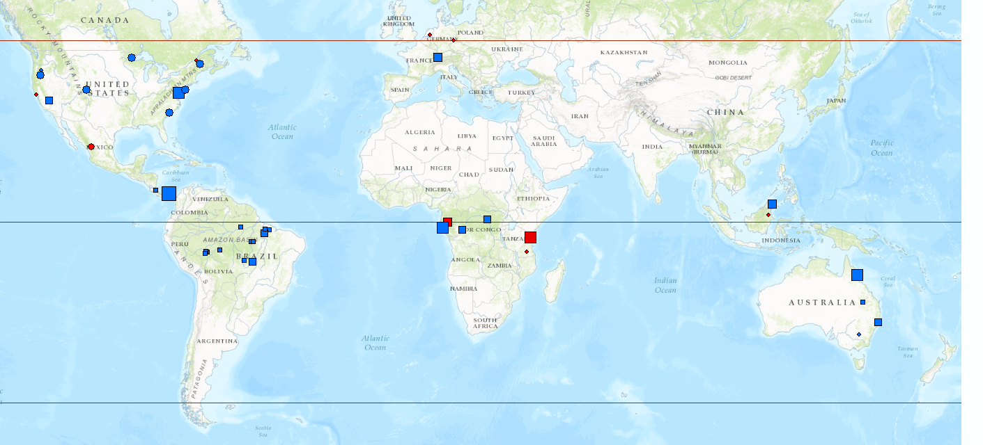


GEDI Biomass Calibration Database (Oct 2016)
2357 plots from 42 projects
28 projects with stem maps
14 projects with plot or subplot level info
0 – 0.5 ha
0.5 – 1.0 ha
1.0 – 4.0 ha
4.0 – 25.0 ha
25.0 - 50.0 ha
John David Armston
AfriSAR Science Team Meeting October 26-28 2016
Notes:
GEDI biomass calibration are relying on community contribution of ground plot and ALS data.
CEOS LPV biomass working group that is tasked with writing a protocol on best practices for biomass EO cal/val.

Slide 18



Where we are today
The Good
We don’t start from scratch. Rainfor, Afritron, CTFS ForestGEO, and others … Many of you have already worked with this data!
The Bad
Funding for these networks is not secured beyond 2018. Data access for the EO community cannot be guaranteed in future!
The Ugly
Measuring AGB with good quality on the ground is expensive. Agencies currently don’t have a programmatic line to fund the collection of the required data.
Notes:
A first order cost estimate for a reference database fit for purpose for BIOMASS resulted in a number of 20 MEuro.

Slide 19
What funding are we talking of – a ballpark estimate
We need: ~500 plots across different biomes + 50 x 50 km² airborne lidar patches for selected sites (supersites)
Plot Data: The full start-to-delivery cost for collecting, storing, quality-control of one 1 ha plot in high-diversity tropical forests is around 15K Euro.
Airborne lidar: The full start-to-delivery cost for collecting, storing, quality-control of 1 km² of lidar data is around 1K Euro.
Total: The estimated cost for the relevant ground data measured twice during the mission life time is around 20M Euro.
Notes:
That's the "ballpark". A serious investment toward this is feasible and would make a big difference

Slide 20
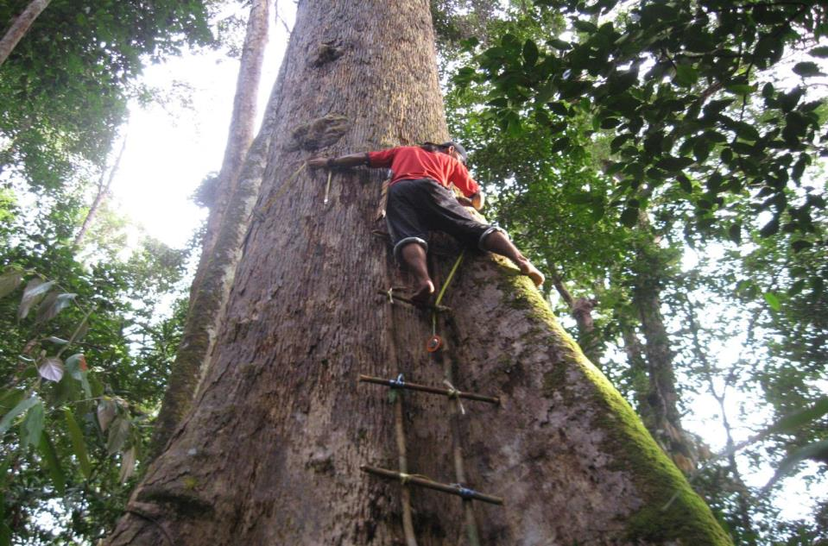
The 4th Mission - ???
The 4th Mission – Global Reference Data
TAKE HOME MESSAGE #3
The EO community needs to get active. It is not all about satellites. Ground data is equally important!
The GFOI community can make a difference
We need a strong recommendation from GFOI for the Agencies and we need to identify alternative solutions.
BIOMASS
These missions will deliver measurements of
forest height
forest biomass
biomass change
Notes:
In a workshop in Washington earlier this year, that brought together experts from the EO and ecological community the term of the 4th mission was created. What is it?
It should bring to the attention of the EO community the importance of ground based measurements and the challenges we face.
GFOI is in a good position to express the need of the community. We need a strong recommendation coming out of this workshop and we need the help of GFOI to identify alternative solutions and influence stakeholders.

Slide 21









Thank you for your attention
Forest-Observation-System.net

